Slide 1








We aspire to be the LEADING PROVIDERS of INNOVATIVE AND IMPACTFUL SOLUTIONS that solve diverse and complex problems in the DIGITAL PAYMENTS and FINANCIAL SERVICES Sectors the World Over.
Open Connect Middleware
Integrated Middleware Platform.

Slide 2


Content
Paysys Middleware Solution
01
Open Connect Middleware Overview &
Architecture
02
Open Connect Middleware Dashboard
03
Open Connect Middleware Case Study

Slide 3
OPEN CONNECT MIDDLEWARE OVERVIEW

Slide 4




OPEN CONNECT MIDDLEWARE OVERVIEW
Variations of Use Cases Covered Across various Open Connect Deployments
Pay by QR/ Bulk QR
Online merchants
Government services
Bill payments
RTP / Bulk RTP
Pay by Card
PAYMENTS
Merchant
Billers
Government
Merchant
Paysys Solution
Centralized Instant Payment System
Process Authorization Request for transfer or payment
ISO20022 Interface
TRANSFERS
P2P, B2B, B2C
C2B, G2C, C2G, A2A, A2W, W2A, W2W, Bulk Transfers
Pay [Person XYZ]
XX
AED
Request to Pay
Bulk Receiving
Send Money (P2P)
Pay by Alias
Customer (banked) Account Holder
Credit Unions

Slide 5

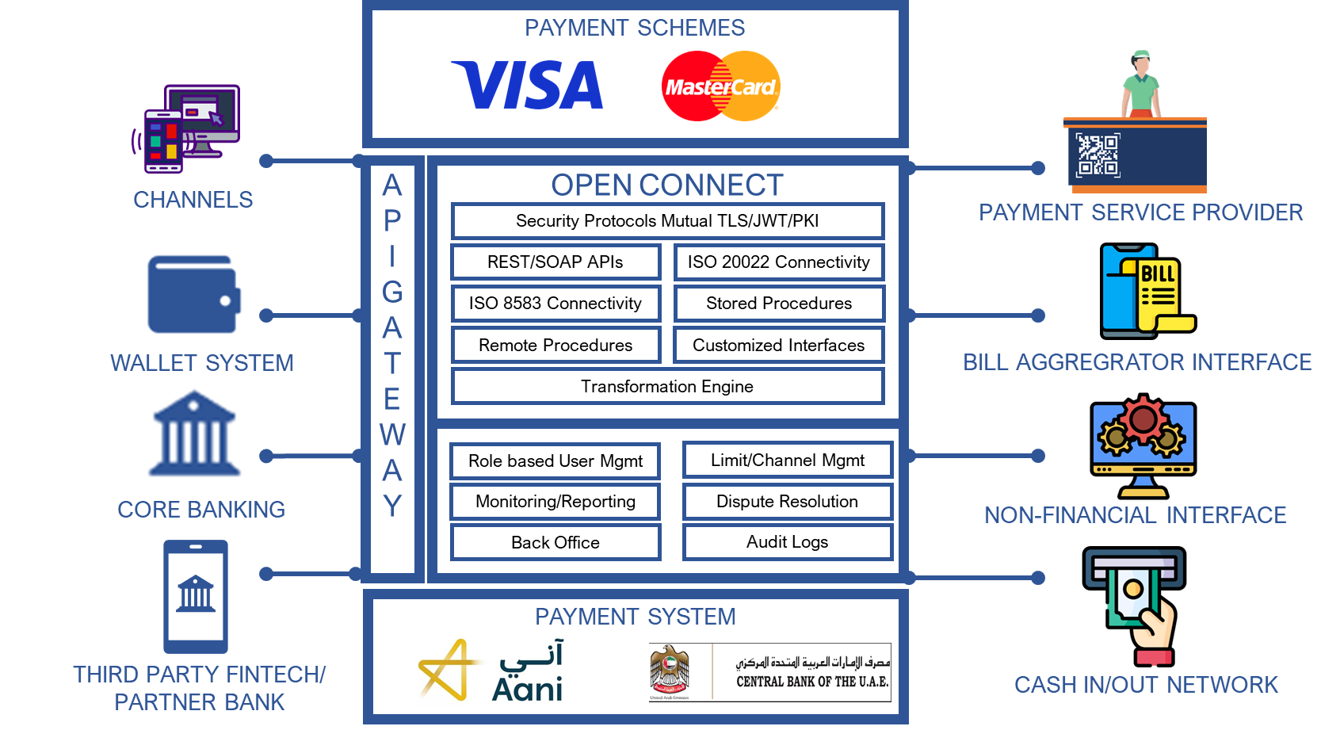
OPEN CONNECT MIDDLEWARE ARCHITECTURE
Open Connect High Level Architecture
Integrated Middleware Platform.
Based on RabbitMQ.
Horizontally Scalable and cloud ready.
Widely utilized for integrating payment systems, core banking platforms, wallets, and digital channels.
Java-based middleware with configurable routing based on single or combined fields.
Supports cross-platform deployment.
Utilizes Elastic Search and Kibana for log monitoring.

Slide 6
OPEN CONNECT MIDDLEWARE MONITORING DASHBAORDS

Slide 7
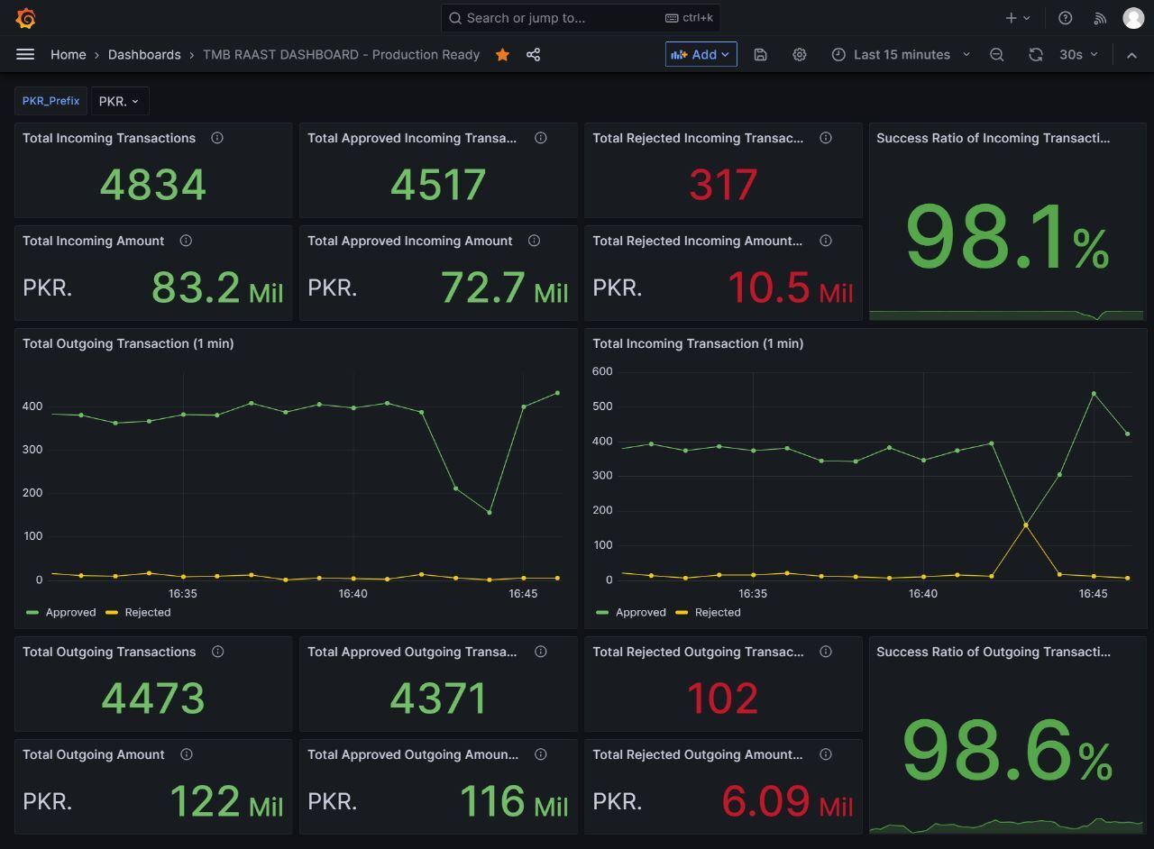
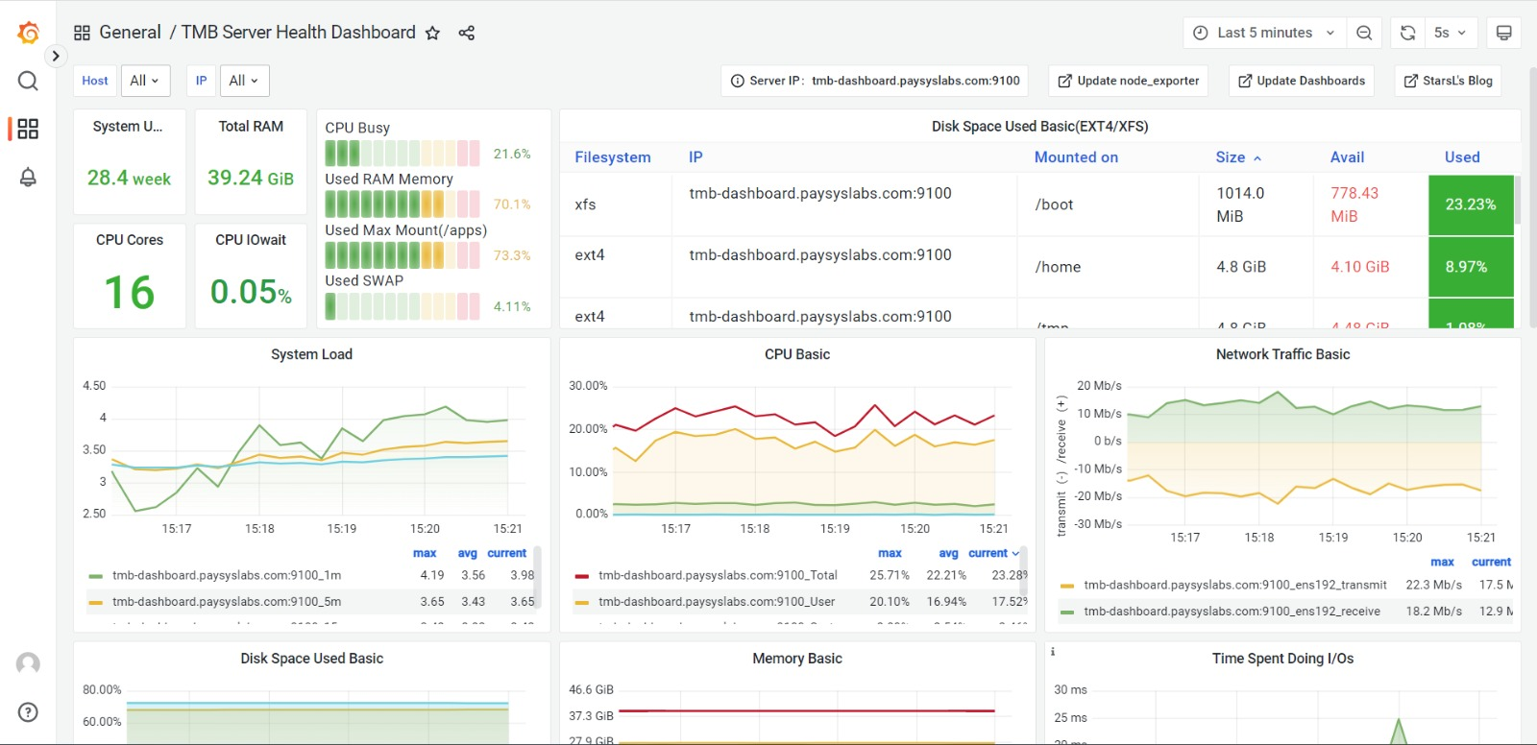
02
OPEN CONNECT MIDDLEWARE DASHBOARD
Monitoring Dashboards
TRANSACTION DASHBOARD
A Comprehensive dashboard providing real-time visualizations and analytics for outbound and inbound payments.
HEALTH STATUS DASHBOARD
This dashboard is used to monitor the Health Status. It will show the precise number of transactions that have been rejected and accepted so user can determine whether the system and API’s are functioning properly.

Slide 8
OPEN CONNECT MIDDLEWARE CLIENTEL

Slide 9





















Open Connect Clientele
What Have We Done In The Instant Payments Space
RAAST – Micro Payment Gateway @ SBP [2018]
Our Instant Payments Expertise
We excel not just in the tech behind Instant Payments but the science, the rationale of What Really Makes An Instant Payment better than a deferred.
We have served as Subject Matter Experts for the development of requirements, selection of vendor, procurement, and implementation of Pakistan’s Instant Payment Platform “RAAST”.
PRISM – Real-Time Gross Settlement System @ SBP [2021]
We are the lead consulting firm that has developed requirements and is in process of selection of vendor, procurement, and implementation of the revamped RTGS platform.
Middleware provider of choice for connecting with Instant Payment System for 20 Financial Institutions. This is on both a hosted as well as on-prem configuration

Slide 10
OPEN CONNECT CASE STUDY

Slide 11






Open Connect Case Study
Digital Bank Case Study
USE CASES
Telenor Easy Paisa Digital Bank has chosen us to implement Open Connect as the intermediary interface between their infrastructure and system.
Bulk
Transfer
P2P
Request To Pay
Payment To Merchant
Standard Rest API Interface
Security Protocols (JWT, PKI, TLS)
Remote Procedure Caller
ISO20022 Interface
Stored Procedure Caller
API Caller (REST, SOAP)
DAILY
MONTHLY
TO DATE
Telenor Bank’s Core Banking
Instant Payment System
VOLUME
750,000+
23 Million+
185 Millions+
Transactional Data
Directory Service
VALUE
7 Million+ USD
197 Million+ USD
2 Billion+ USD
Audit Logs
TRANSACTIONAL THROUGHPUT OF SYSTEM

